Slide 1
The Roller Coaster of Developing SynthEddy
Approximating Turbulent Flow with Synthetically Generated Eddies
Phil Du

Slide 2
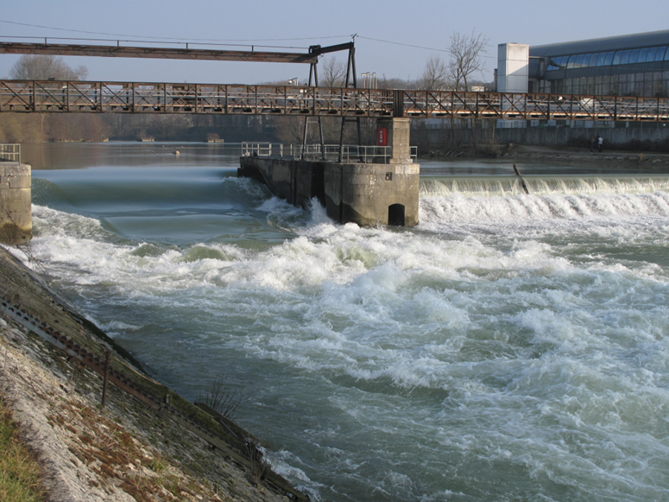
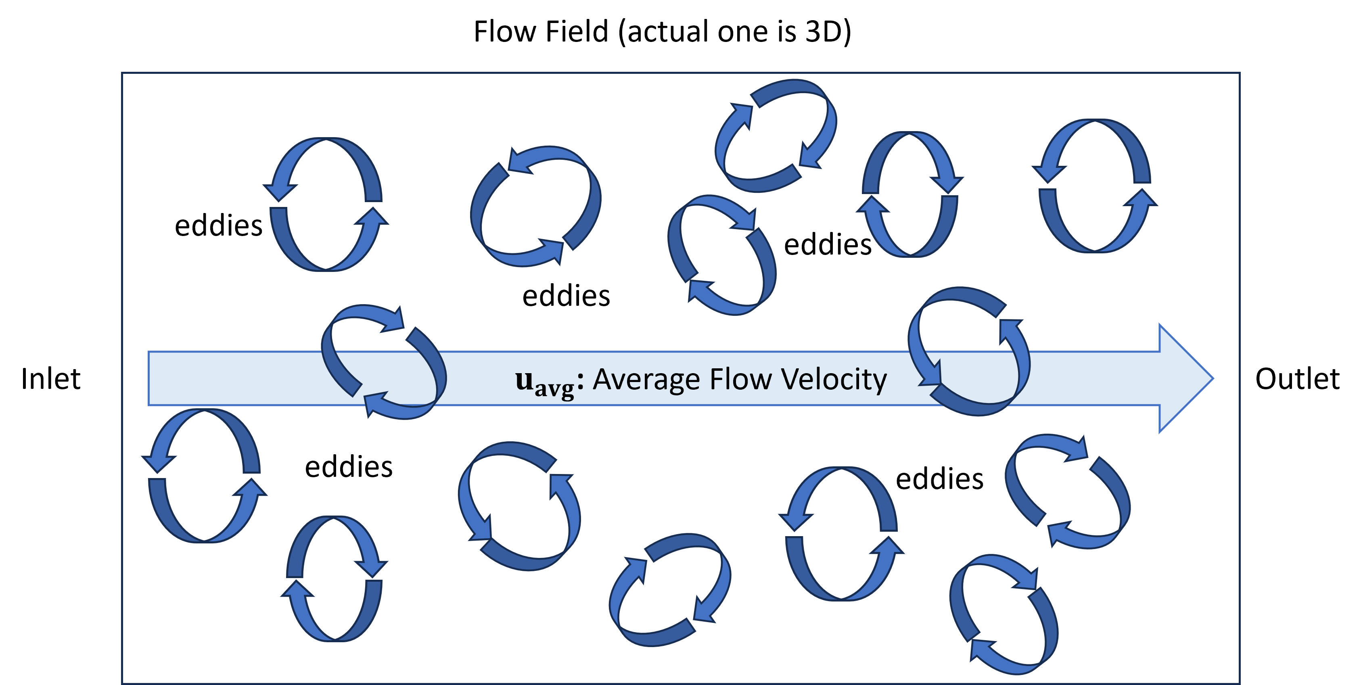
Recap
Credit: https://commons.wikimedia.org/wiki/User:Tangopaso

Slide 3
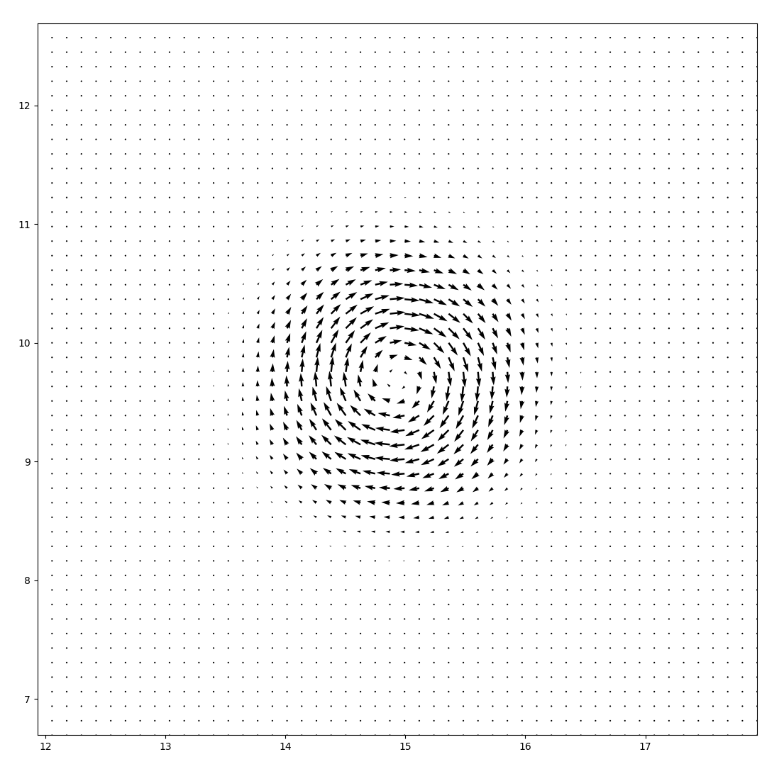
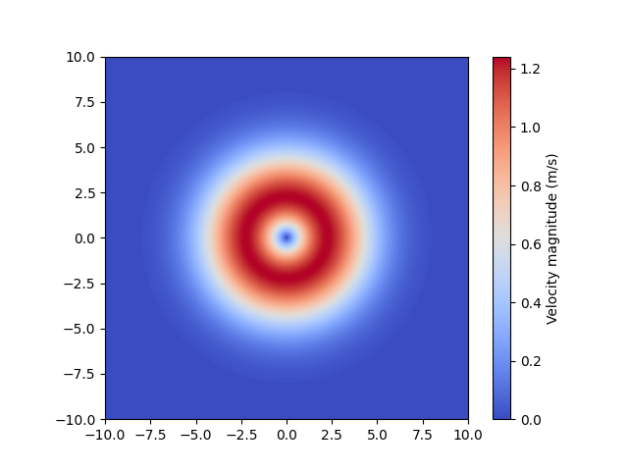
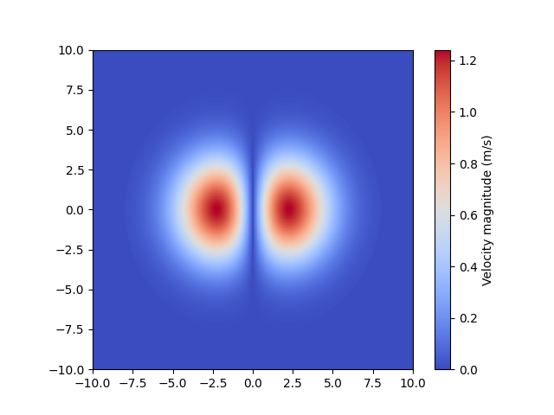
Visualize an Eddy
$$u^{'}\left(x\right)=\sum_{k=1}^{N}{q(d_{k}(x), σ_{k})r_{k}(x)×α_{k}}$$

Slide 4
About This Presentation
“Demo”
Original implementation idea
Actual implementation

Slide 5
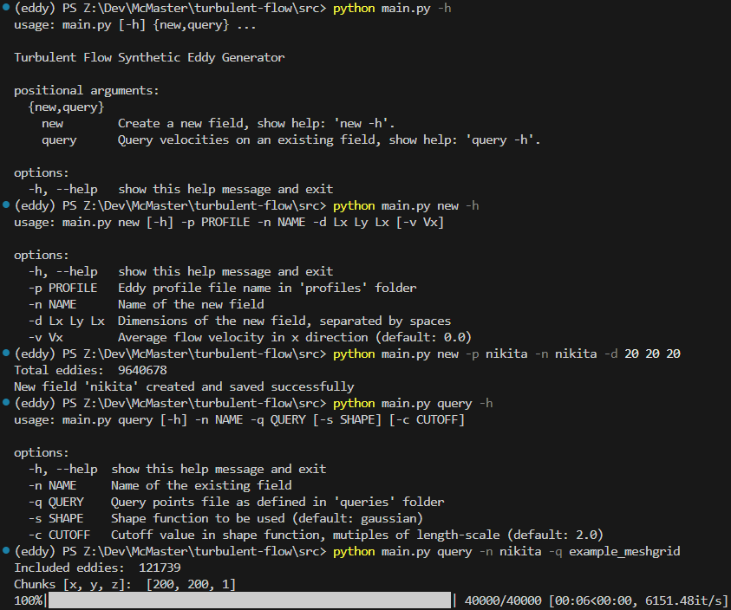
Usage

Slide 6
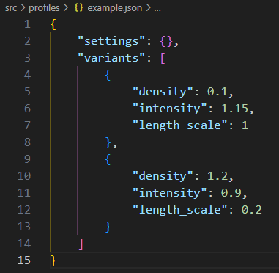
Usage
Eddy Profile

Slide 7
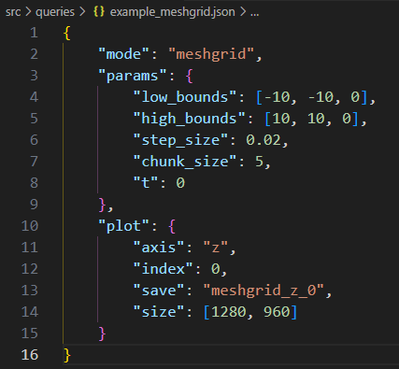
Usage
Query Inputs

Slide 8
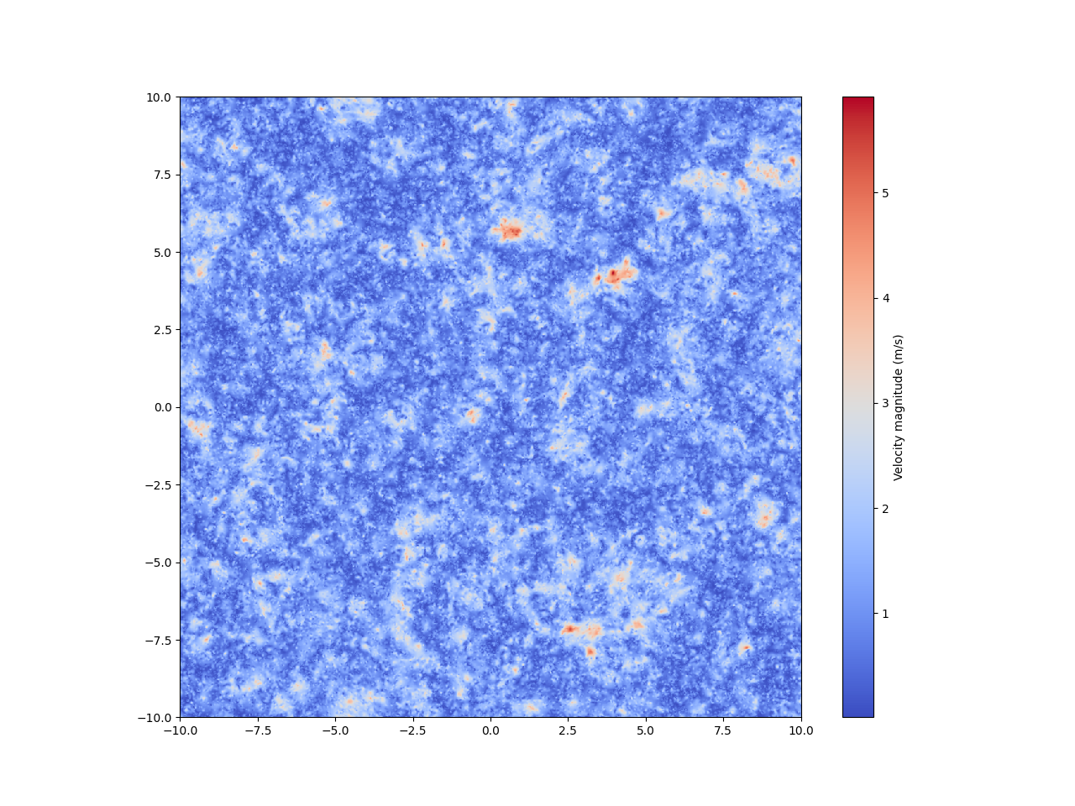
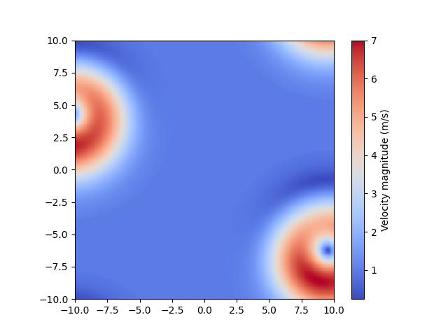
Result
Wrap-around

Slide 9


Slide 10


Slide 11
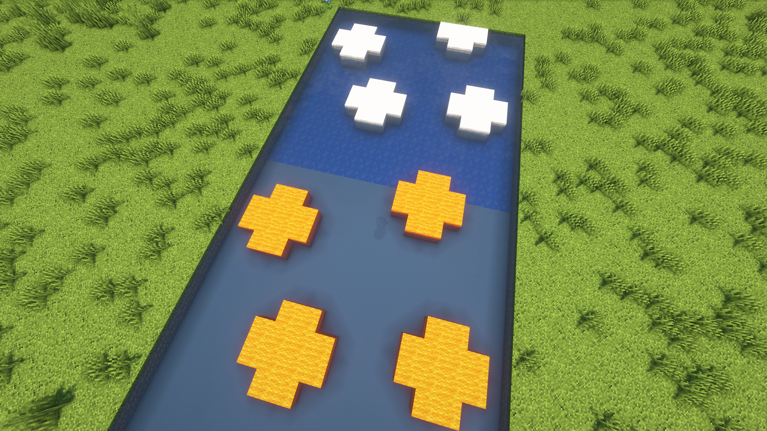

Slide 12
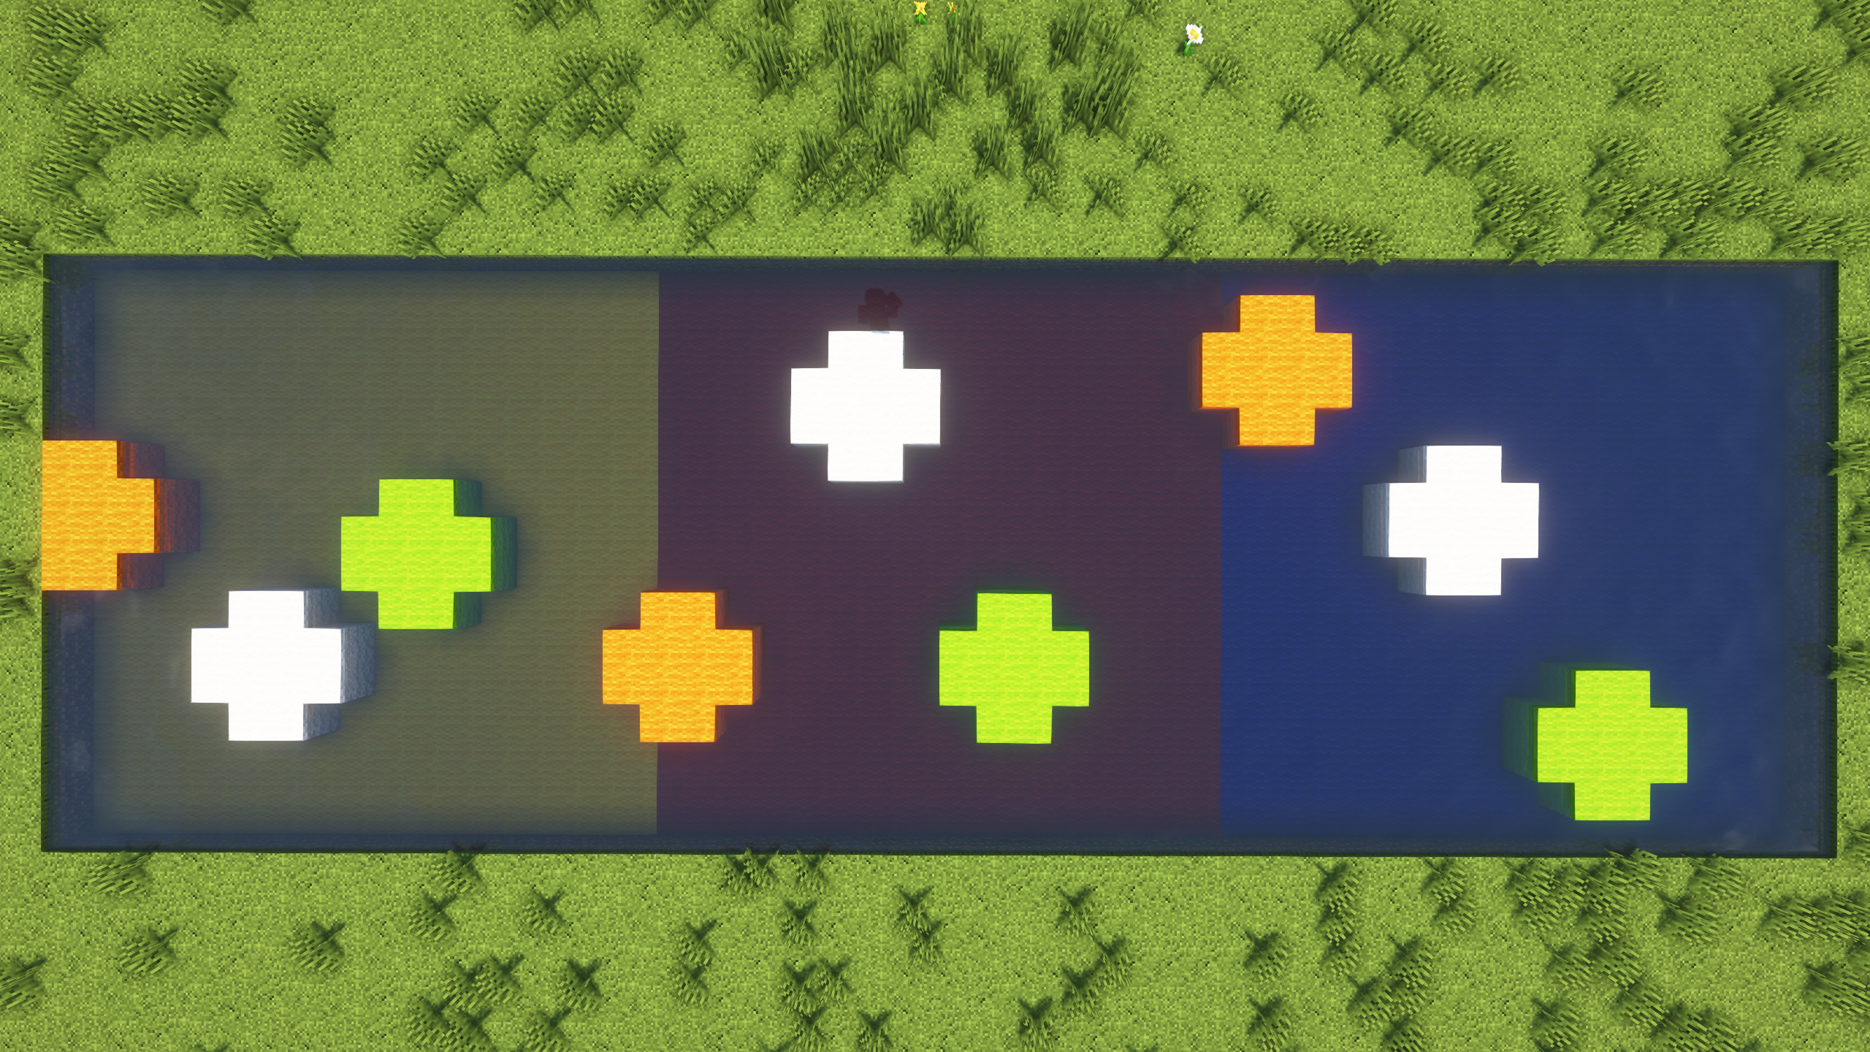

Slide 13
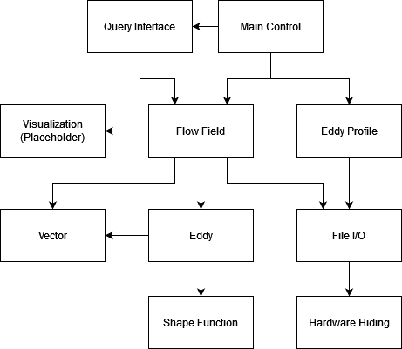
Original Plan
Each eddy as a ADT object
Modularity and information hiding
Stay close the theoretical models
Only store its center position, intensity and orientation
instead of its mini velocity field
No discretization when generating
Call method of eddy object to get velocity influence on certain point
The original modules design

Slide 14
A Love Letter to Dr. Smith
My first time developing a software in such a structured manner
With SRS, MG and MIS
It was a SMOOTH operation (initially...)
High confidence with pytest
The original modules design

Slide 15
The Curve Ball
Introducing Nikita
Mismatch of expectations
The dreaded MATLAB run
1000³ mesh grid
1200 eddies per m³, in 20m cube
Famous last word
How bad can it be?
The original modules design

Slide 16
Can NumPy Save the Day?
NumPy: Broadcast operations between arrays/matrices
Move eddy info to Flow Field module as arrays
×
$$u^{'}\left(x\right)=\sum_{k=1}^{N}{q(d_{k}(x), σ_{k})r_{k}(x)×α_{k}}$$
The sum of all evil
The compromised modules design

Slide 17
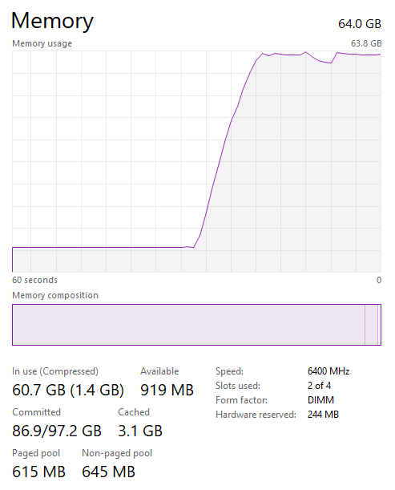
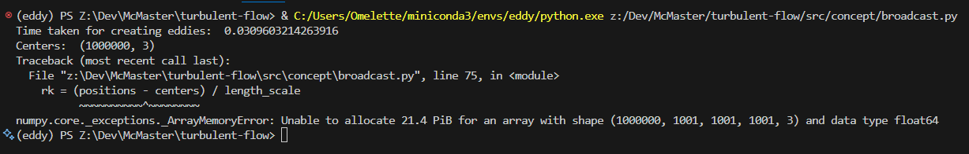
Oh No, I’m Gonna Fail
$$u^{'}\left(x\right)=\sum_{k=1}^{N}{q(d_{k}(x), σ_{k})r_{k}(x)×α_{k}}$$
The sum of all evil
1 billion × 10 million × 3 × 64bit = Please download more RAM

Slide 18
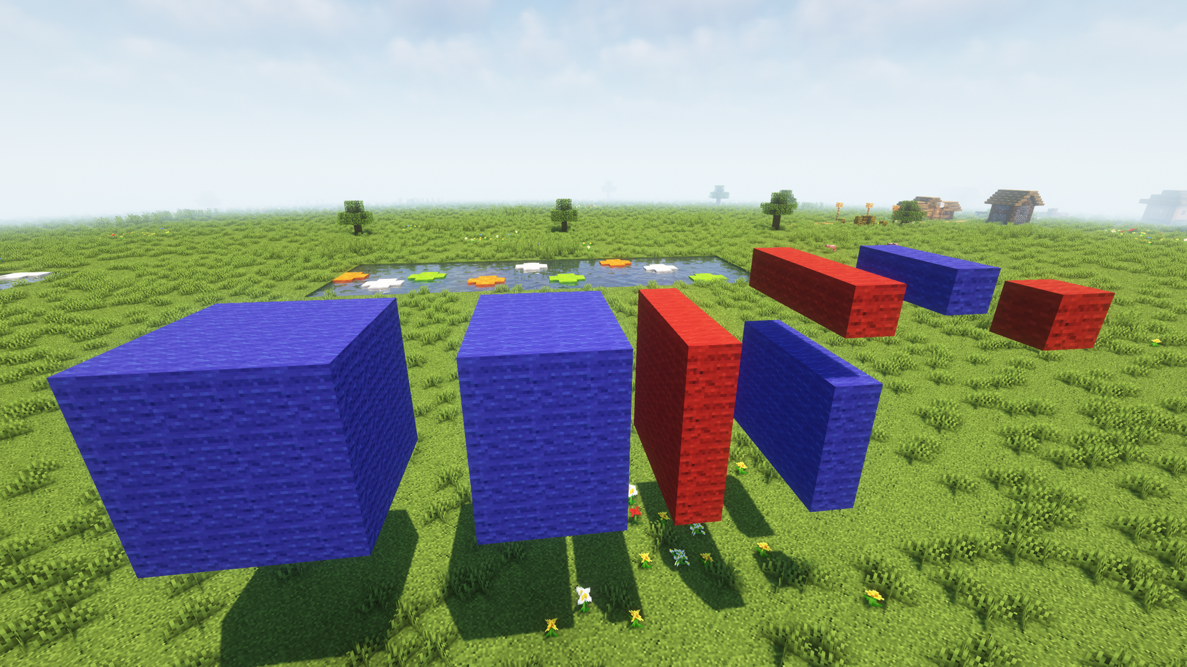

Slide 19
Performance Benchmark
1000³ (1 billion) mesh grid
10 million eddies
Memory usage: 24.5 GB
Much lower if cache to disk
1 hour on a single thread

Slide 20
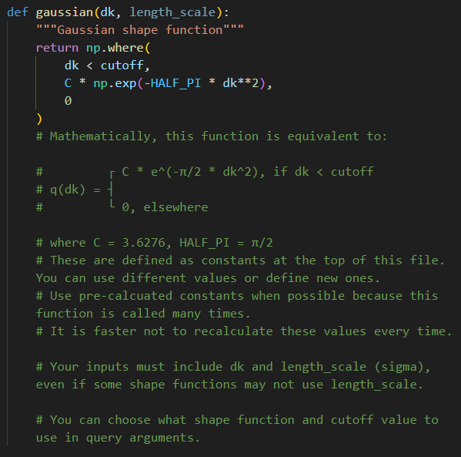
NFR: Maintainability
Let’s add a new shape function!
If I give you...
Can you implement the quadratic shape function?
$$q\left(d_{k}\right)=\left\{\begin{aligned}σ\left(1-{d_{k}}^{2}\right), if{ d}_{k}<1 \\ 0, elsewhere\end{aligned}\right.$$

Slide 21
Future Works
New:
What to do with the results?
Multithreading (should be straightforward)
Non-spherical eddies (oblong / fat)
From SRS:
Generate realistic eddy profile before use
CFD interface
Far future:
Multi-eddy interactions
Non-uniform flow velocity

Slide 22
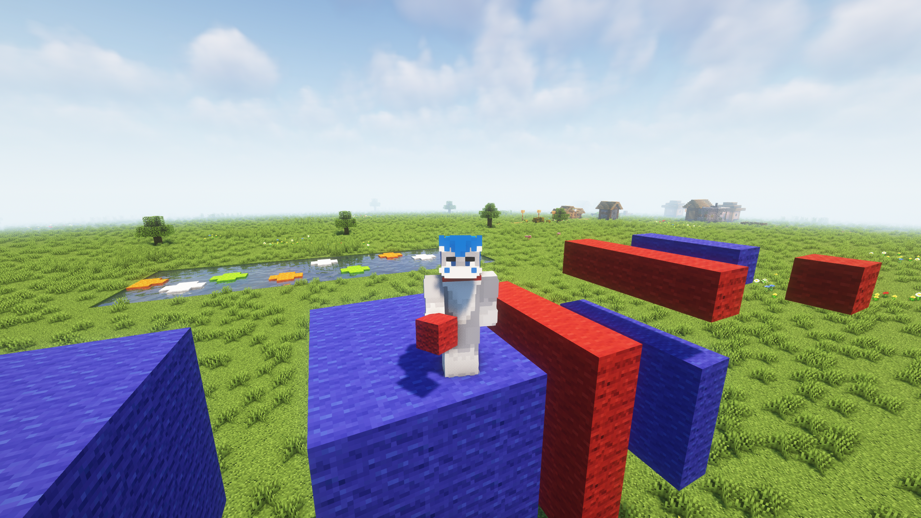
Thank you for watching!
Comments? Questions?

